Slide 1
FitDay
Healthy day for you
DATA REVOLVERS
SUMIT DESHMUKH, MAANSI CHANDIRA, LEANDRA MENEZES, VIPRA SHAH
TA: ABHIJEET PATIL

Slide 2
Diabetes – Now and Future
Over 21 million people of the population are suffering from diabetes in USA alone.
More than 8 million people have diabetes yet unaware about it.
Common symptoms of diabetes: Cuts/bruises that are slow to heal, Feeling very hungry - even though you are eating.
Current diagnosing technique involves invasive blood tests such as
1) Random blood sugar test and
2) Fasting blood sugar test.
Necessity of noninvasive technique to continuously monitor glucose is the need of the hour.
Evolution of bio - chemical sensors has made it possible to measure glucose level from Saliva.
FitDay foresees that fitness tracker devices will include biosensors to monitor a Diabetic patient in the near future.
Having glucose information as easy as heart rate or calories burned will be vital to live a healthy life.
Notes:
http://www.cdc.gov/diabetes/data/statistics/2014statisticsreport.html,
http://www.diabetes.org/diabetes-basics/symptoms/#sthash.EySKLFDm.dpuf

Slide 3
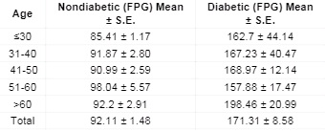
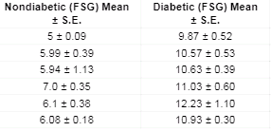
Calculations
For running activity on flat surface: CB = [0.0215 x KPH³ - 0.1765 x KPH² + 0.8710 x KPH + 1.4577] x WKG x T
    CB = Calorie burn (in calories)
    KPH = Running speed (in kilometres per hour)
    WKG = Weight (in kilograms)
    T = Time (in hours)
For Diabetic patients:

Slide 4
Conclusion
using triggers,
functions,
procedures
applying normalization and
denormalization techniques
indexing we can retrieve data fast and maintain data easily

Slide 5
References
Noninvasive Method for Glucose Level Estimation by Saliva
Agrawal RP1*, Sharma N2, Rathore MS2, Gupta VB2, Jain S1, Agarwal V1 and Goyal S1
2014 diabetes statistics report-CDC
Diabetes.org journal
Walking Calorie Burn Formula
Glucose levels in normal people and in diabetic patients
D. K. Sen And G. S. Sarin

Slide 6
Acknowledgements
Prof. Chaiyaporn Mutsalklisana
TA’s: Abhijeet Patil

